Slide 1







Have some dinner
Grab a seat
Join our Slack
Vegetarian options available
WiFi connection information is in the bottom-right corner
Visit http://civte.ch
Click “Slack”
Submit e-mail
Boom!
First time? Have any questions?
Find an organizer! It’s our first time too!

Slide 2

Waterloo
Region

Slide 3

What is Civic Tech Waterloo Region?
CivicTechWR is an inclusive multi-disciplinary group that aims to connect citizens, civic innovators, technologists, community groups, governments, and entrepreneurs with civic tech initiatives. We strive to empower them to work together, exchange ideas and tools to improve the lives of the residents in and around Waterloo Region through civic technology.
TL;DR: Any technology that intersects public life.

Slide 4

Our Code of Conduct
Civic Tech Waterloo Region is dedicated to providing a harassment-free environment for everyone, regardless of gender, gender identity and expression, sexual orientation, disability, physical appearance, body size, race, age or religion or technical skill level. We do not tolerate harassment of participants in any form.

Slide 5

Venue Sponsor

Slide 6

Introduce Yourself!
Your name
Your reason for coming
Is it your first time?
Please keep announcements for after the presentation!

Slide 7


Tonight’s Presentations
Justin Watkins, City of Kitchener
Karl Allen-Muncey, Kitchener Innovation Lab
You?
Your Suggestions Welcome!
Notes:
Add a slide on how to stay connected

Slide 8
Justin Watkins, City of Kitchener

Slide 9
Karl Allen-Muncey, Kitchener Innovation Lab

Slide 10

Tell us about your project
Your name
Your project’s name
What’s your goal?
What do you need?

Slide 11

Outline
Introduction to Open Food Network
Theresa Schumilas
tschumilas@rogers.com/info@openfoodnetwork.ca

Slide 12
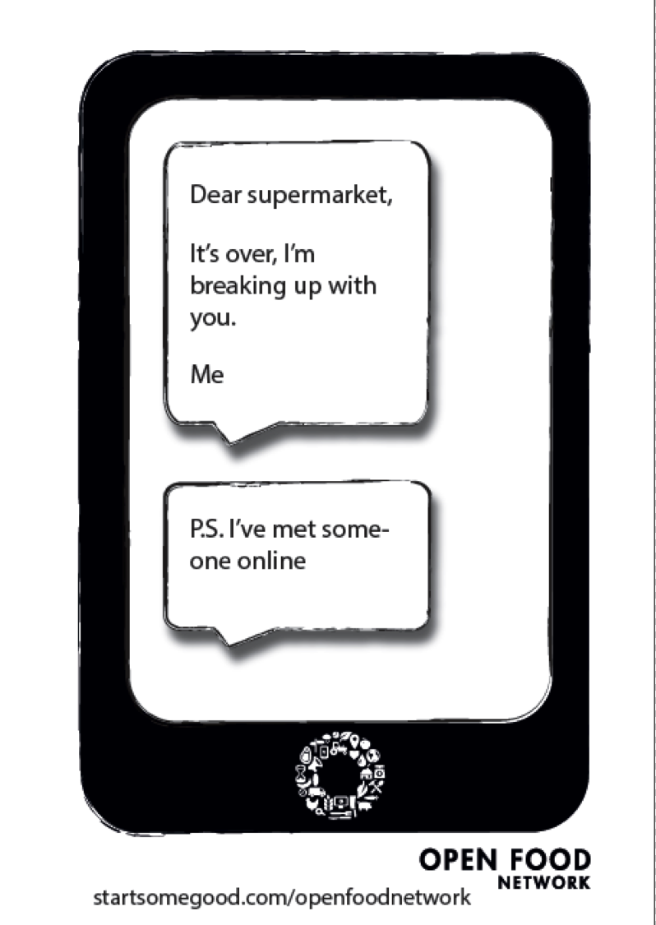

Slide 13
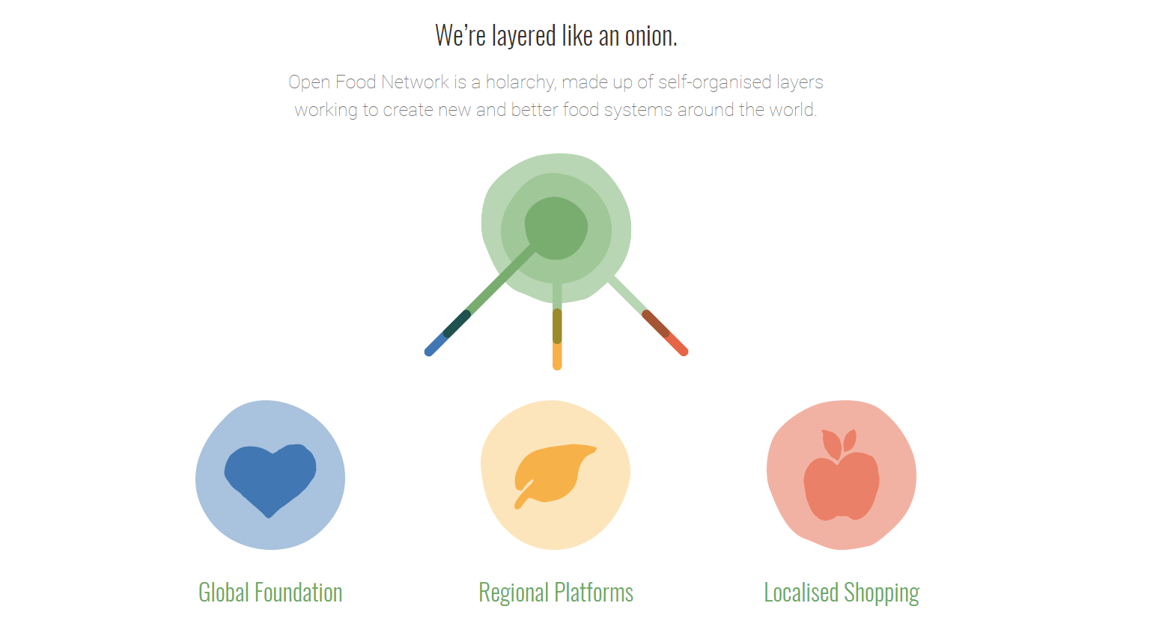

Slide 14
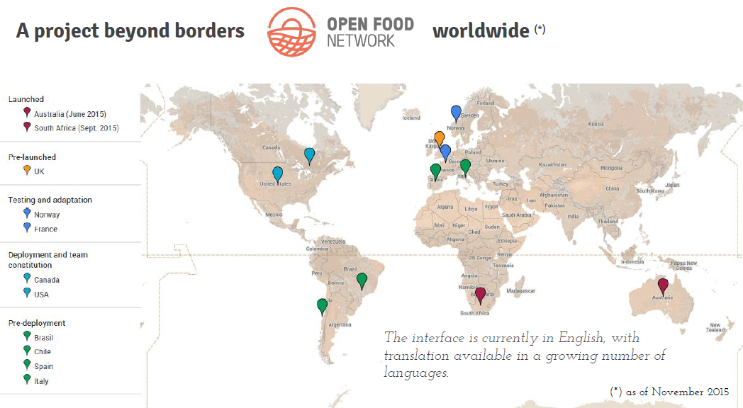
Open Food Network - GLOBAL
A network of sister organizations around the world who collaborate on building a ‘food + tech commons’ to move the food movement.

Slide 15
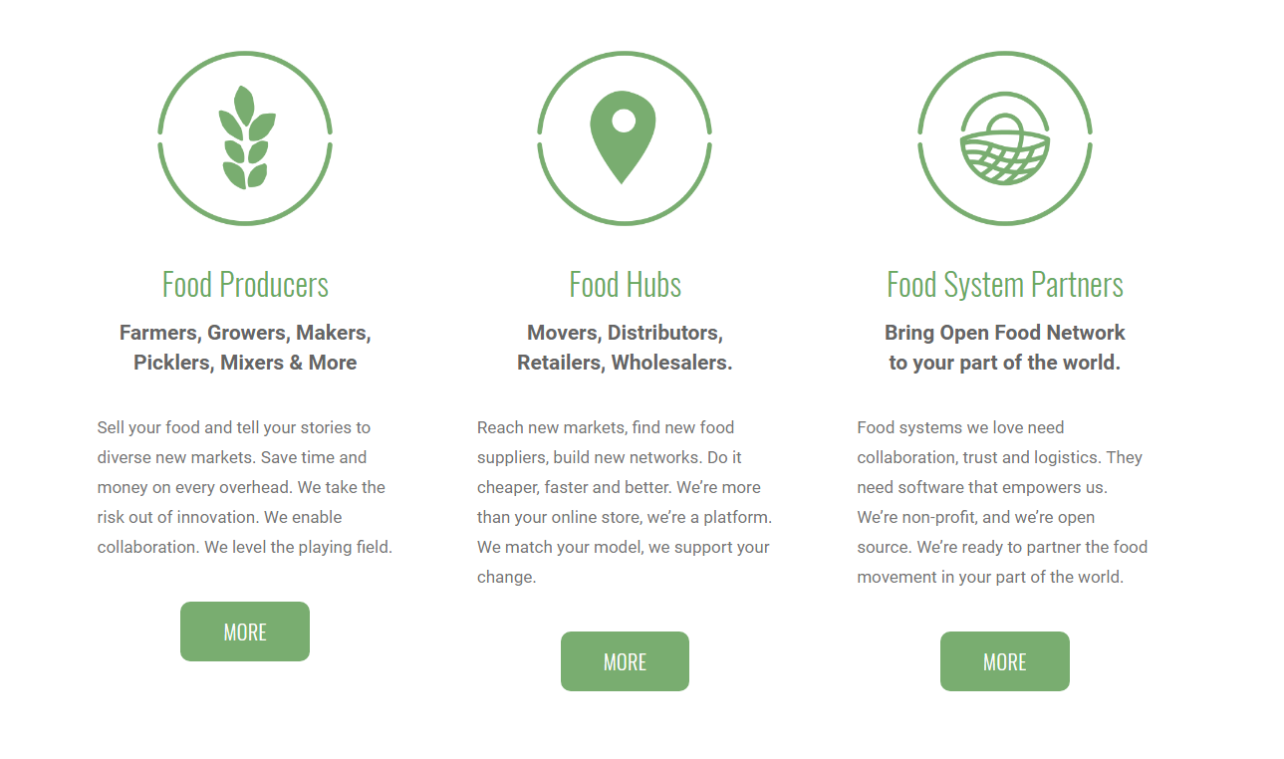

Slide 16
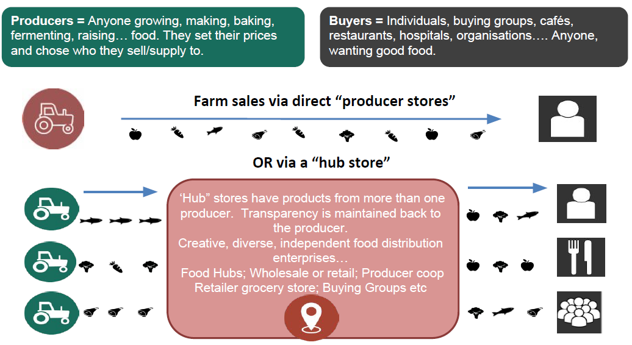
Open Food Network – The Platform

Slide 17
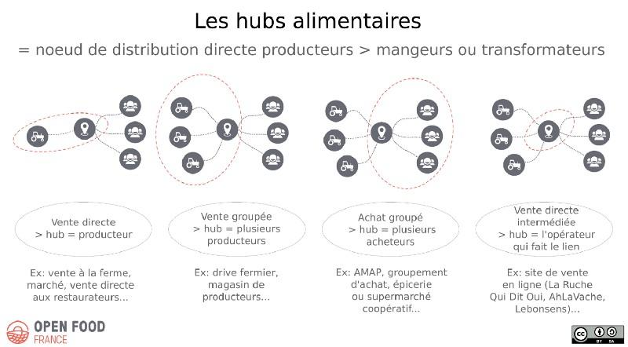
Direct Sales - no intermediary
Producers form a marketing group
Consumers form a buying group
‘Food Hub’ – an intermediary links buyers & sellers

Slide 18

Producer/Supplier can sell to multiple hubs and manage one virtual
Inventory. Quantities can be designated to hubs, and prices, and any
Other fees (shipping, admin) can be set up differently for each hub.

Slide 19
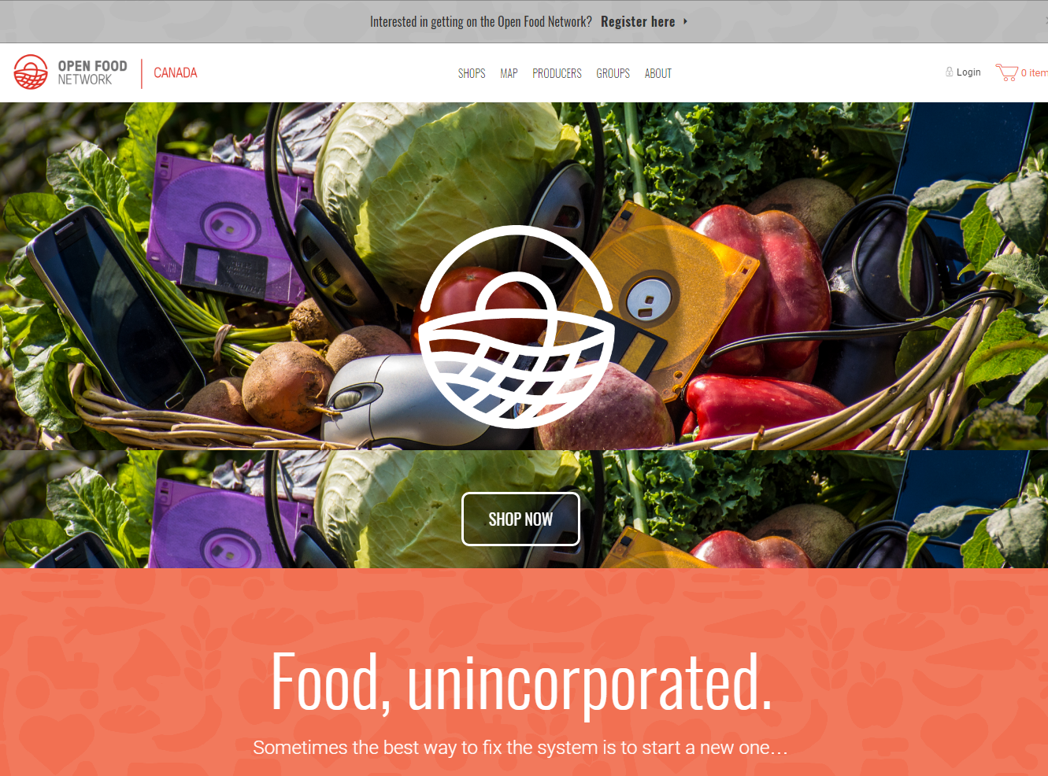

Slide 20
We need you!!!
Ruby on Rails full stack developer interested in freelance projects
Someone who knows Gitbook – new user guide
Anyone good with Wordpress - our ‘about us’… pages are really bad
Desperate for help with on-boarding webinars or hangouts
We have no social media presence yet - HELP!!
Or – just contact me to learn more…
Theresa Schumilas
tschumilas@rogers.com/info@openfoodnetwork.ca

Slide 21
Breakouts!
Project | Lead(s) | Description / Needs
Civic Tech 101 | Doug | Come here if it’s your first time!!!!
Future Tech | Kristina | Brainstorm new and future projects
Open Food Network | Theresa | Very early stages; All help welcome

Slide 22
Project | Lead(s) | Description / Needs
Civic Tech 101 | Doug | Come here if it’s your first time!!!!
Future Tech | Kristina | Brainstorm new and future projects
Open Food Network | Theresa | Very early stages; All help welcome

Slide 23






Do your part
See you next month!
meetup.com/CivicTechWR
Throw out any waste
facebook.com/CivicTechWR
Put furniture back in place
twitter.com/CivicTechWR
Don’t dally!
CivTe.ch
Out of respect for our hosts,
please leave by 8:30p sharp
CivicTechWR.slack.com
hello@civte.ch
github.com/CivicTechWR

Slide 25
Keep In Touch
civte.ch
Meetup.com
Join our Slack
Videos & slides from presentations
Notes from Project Leads
Information on all things Civic Tech
Details on each month’s hacknight:
Where
Who
Important Details
Visit http://civte.ch
Click “Slack”
Submit email
Boom!
@CivicTechWR
/CivicTechWR

Slide 26


